Slide 1
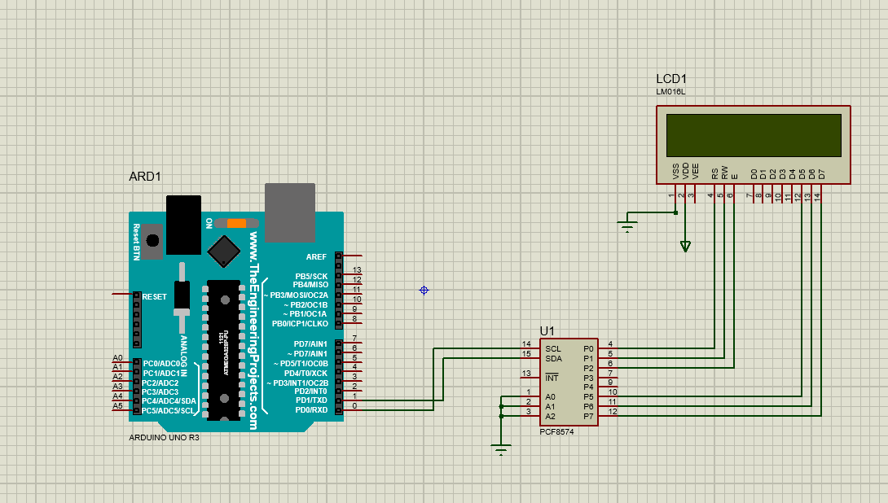
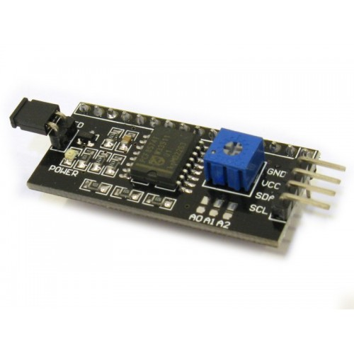
Using I2C backpack module
The usage of the i2c backpack module reduces the number of pins from 8 to 2.

